Slide 1
Input/Output
Chapter 5
Tanenbaum & Bo,Modern Operating Systems:4th ed., (c) 2013 Prentice-Hall, Inc. All rights reserved.

Slide 2
I/O Devices (1)
Block devices
  Stores information in fixed-size blocks, each one with its own address
  Transfers are in units of entire blocks
  Common block sizes range from 512 to 65,536 bytes
Character devices
  Delivers or accepts stream of characters, without regard to block structure
  Not addressable, does not have any seek operation
Tanenbaum & Bo,Modern Operating Systems:4th ed., (c) 2013 Prentice-Hall, Inc. All rights reserved.

Slide 3
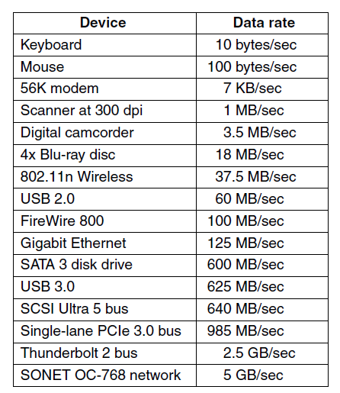
I/O Devices (2)
Figure 5-1. Some typical device, network, and bus data rates.
Tanenbaum & Bo,Modern Operating Systems:4th ed., (c) 2013 Prentice-Hall, Inc. All rights reserved.

Slide 4
Device Controller
I/O units often consist of a mechanical component and an electronic component.
  It is possible to separate the two portions to provide a more modular and general design.
The electronic component is called the device controller or adapter. On personal computers, it often takes the form of a chip on the parentboard or a printed circuit card that can be inserted into a (PCIe) expansion slot.
The mechanical component is the device itself
Tanenbaum & Bo,Modern Operating Systems:4th ed., (c) 2013 Prentice-Hall, Inc. All rights reserved.

Slide 5
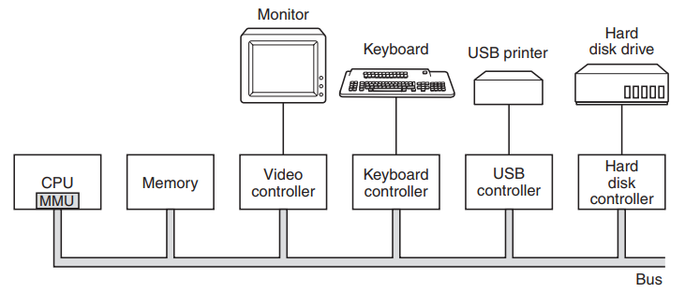
Device Controller (contd.)
Tanenbaum & Bo,Modern Operating Systems:4th ed., (c) 2013 Prentice-Hall, Inc. All rights reserved.

Slide 6
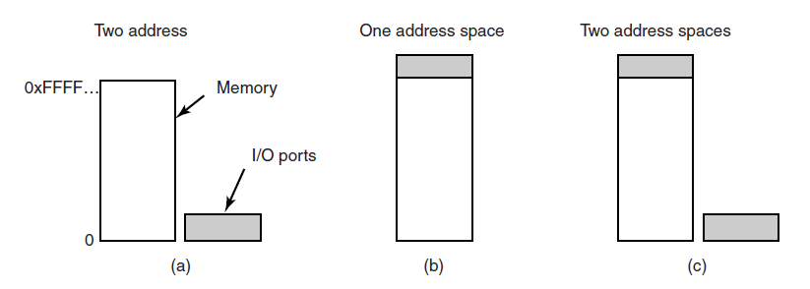
Memory-Mapped I/O (1)
Figure 5-2. (a) Separate I/O and memory space.
(b) Memory-mapped I/O. (c) Hybrid.
Tanenbaum & Bo,Modern Operating Systems:4th ed., (c) 2013 Prentice-Hall, Inc. All rights reserved.

Slide 7
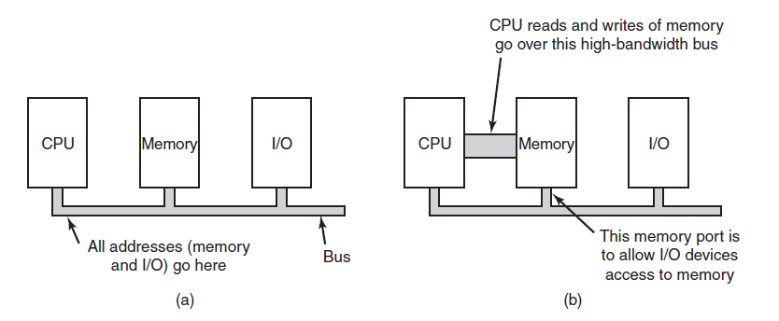
Memory-Mapped I/O (2)
Figure 5-3. (a) A single-bus architecture.
(b) A dual-bus memory architecture.
Tanenbaum & Bo,Modern Operating Systems:4th ed., (c) 2013 Prentice-Hall, Inc. All rights reserved.

Slide 8
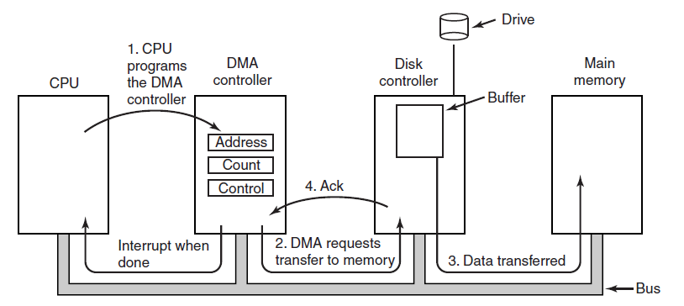
Direct Memory Access
Figure 5-4. Operation of a DMA transfer.
Tanenbaum & Bo,Modern Operating Systems:4th ed., (c) 2013 Prentice-Hall, Inc. All rights reserved.

Slide 9
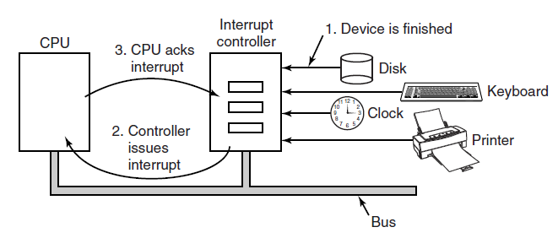
Interrupts Revisited
Figure 5-5. How an interrupt happens. The connections between the devices and the interrupt controller actually use interrupt lines on the bus rather than dedicated wires.
Tanenbaum & Bo,Modern Operating Systems:4th ed., (c) 2013 Prentice-Hall, Inc. All rights reserved.

Slide 10
Precise Interrupt
Four properties of a precise interrupt:
The PC saved in a known place.
All instructions before that pointed to by PC have fully executed.
No instruction beyond that pointed to by PC has been executed.
Execution state of instruction pointed to by PC is known.
Tanenbaum & Bo,Modern Operating Systems:4th ed., (c) 2013 Prentice-Hall, Inc. All rights reserved.

Slide 11
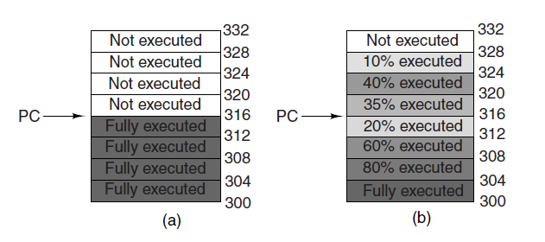
Precise vs. Imprecise
Figure 5-6. (a) A precise interrupt. (b) An imprecise interrupt.
Tanenbaum & Bo,Modern Operating Systems:4th ed., (c) 2013 Prentice-Hall, Inc. All rights reserved.

Slide 12
Goals of the I/O Software
Issues:
Device independence
Uniform naming
Error handling
Synchronous versus asynchronous
Buffering.
Tanenbaum & Bo,Modern Operating Systems:4th ed., (c) 2013 Prentice-Hall, Inc. All rights reserved.

Slide 13
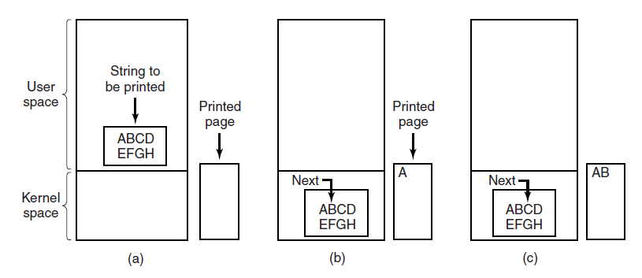
Programmed I/O (1)
Figure 5-7. Steps in printing a string.
Tanenbaum & Bo,Modern Operating Systems:4th ed., (c) 2013 Prentice-Hall, Inc. All rights reserved.

Slide 14
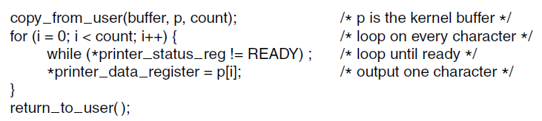
Programmed I/O (2)
Figure 5-8. Writing a string to the printer
using programmed I/O.
Tanenbaum & Bo,Modern Operating Systems:4th ed., (c) 2013 Prentice-Hall, Inc. All rights reserved.

Slide 15
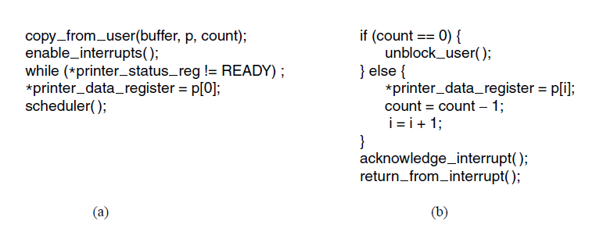
Interrupt-Driven I/O
Figure 5-9. Writing a string to the printer using interrupt-driven I/O. (a) Code executed at the time the print system call is made. (b) Interrupt service procedure for the printer.
Tanenbaum & Bo,Modern Operating Systems:4th ed., (c) 2013 Prentice-Hall, Inc. All rights reserved.

Slide 16
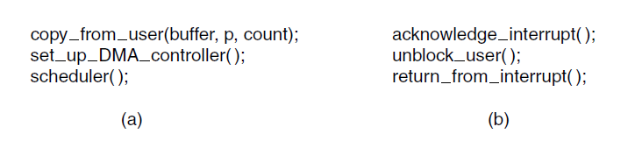
I/O Using DMA
Figure 5-10. Printing a string using DMA. (a) Code executed when the print system call is made. (b) Interrupt service procedure.
Tanenbaum & Bo,Modern Operating Systems:4th ed., (c) 2013 Prentice-Hall, Inc. All rights reserved.

Slide 17
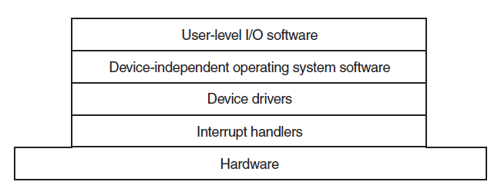
I/O Software Layers
Figure 5-11. Layers of the I/O software system.
Tanenbaum & Bo,Modern Operating Systems:4th ed., (c) 2013 Prentice-Hall, Inc. All rights reserved.

Slide 18
Interrupt Handlers (1)
Typical steps after hardware interrupt completes:
Save registers (including the PSW) not already saved by interrupt hardware.
Set up context for interrupt service procedure.
Set up a stack for the interrupt service procedure.
Acknowledge interrupt controller. If no centralized interrupt controller, reenable interrupts.
Copy registers from where saved to process table.
Tanenbaum & Bo,Modern Operating Systems:4th ed., (c) 2013 Prentice-Hall, Inc. All rights reserved.

Slide 19
Interrupt Handlers (2)
Typical steps after hardware interrupt completes:
Run interrupt service procedure. Extract information from interrupting device controller’s registers.
Choose which process to run next.
Set up the MMU context for process to run next.
Load new process’ registers, including its PSW.
Start running the new process.
Tanenbaum & Bo,Modern Operating Systems:4th ed., (c) 2013 Prentice-Hall, Inc. All rights reserved.

Slide 20
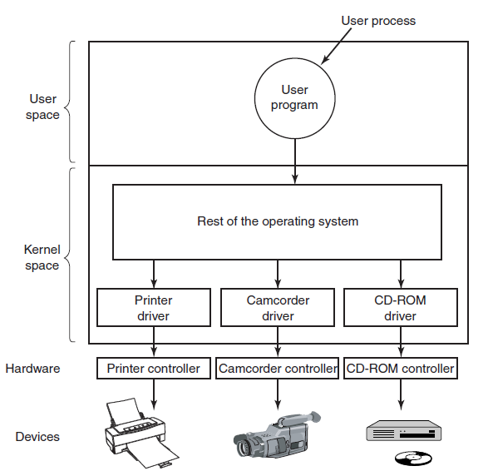
Device Drivers
Figure 5-12. Logical positioning of device drivers.
In reality all communication between drivers
and device controllers goes over the bus.
Tanenbaum & Bo,Modern Operating Systems:4th ed., (c) 2013 Prentice-Hall, Inc. All rights reserved.

Slide 21
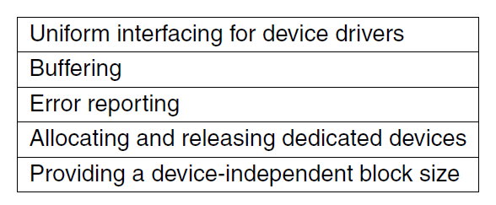
Device-Independent I/O Software
Figure 5-13. Functions of the
device-independent I/O software.
Tanenbaum & Bo,Modern Operating Systems:4th ed., (c) 2013 Prentice-Hall, Inc. All rights reserved.

Slide 22
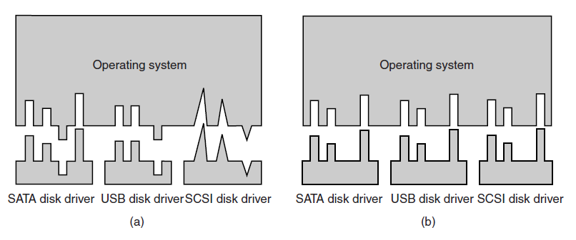
Uniform Interfacing for Device Drivers
Figure 5-14. (a) Without a standard driver interface.
(b) With a standard driver interface.
Tanenbaum & Bo,Modern Operating Systems:4th ed., (c) 2013 Prentice-Hall, Inc. All rights reserved.

Slide 23
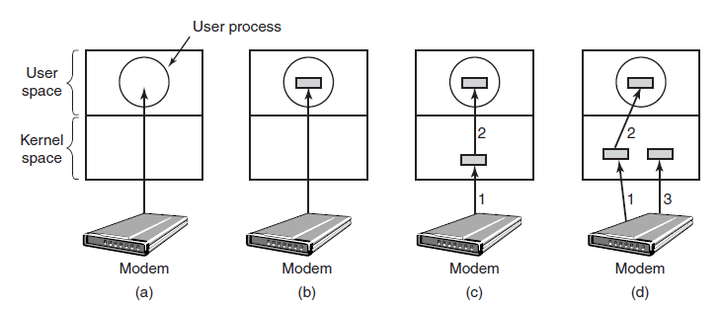
Buffering (1)
Figure 5-15. (a) Unbuffered input. (b) Buffering in user space. (c) Buffering in the kernel followed by copying to user space. (d) Double buffering in the kernel.
Tanenbaum & Bo,Modern Operating Systems:4th ed., (c) 2013 Prentice-Hall, Inc. All rights reserved.

Slide 24
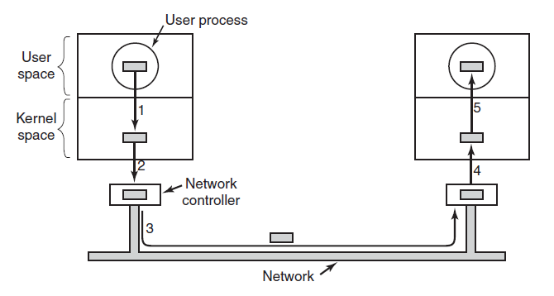
Buffering (2)
Figure 5-16. Networking may involve many
copies of a packet.
Tanenbaum & Bo,Modern Operating Systems:4th ed., (c) 2013 Prentice-Hall, Inc. All rights reserved.

Slide 25
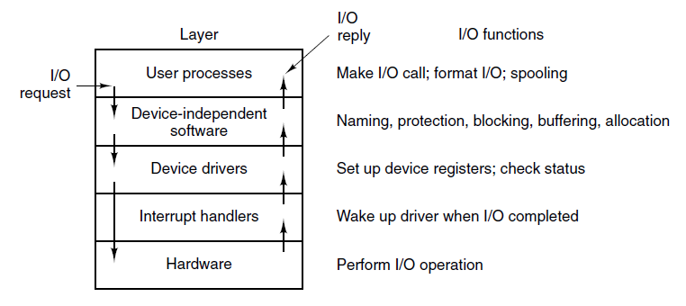
User-Space I/O Software
Figure 5-17. Layers of the I/O system and
the main functions of each layer.
Tanenbaum & Bo,Modern Operating Systems:4th ed., (c) 2013 Prentice-Hall, Inc. All rights reserved.

Slide 26
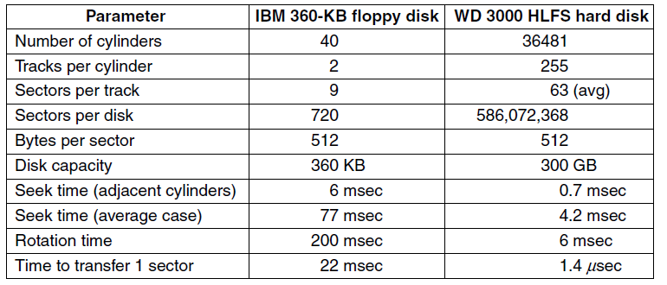
Magnetic Disks (1)
Figure 5-18. Disk parameters for the original IBM PC 360-KB floppy disk and a Western Digital WD 3000 HLFS (‘‘Velociraptor’’) hard disk.
Tanenbaum & Bo,Modern Operating Systems:4th ed., (c) 2013 Prentice-Hall, Inc. All rights reserved.

Slide 27
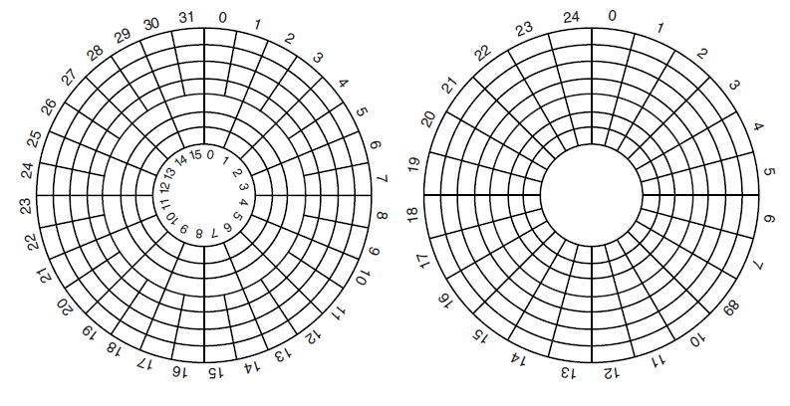
Magnetic Disks (2)
Figure 5-19. (a) Physical geometry of a disk with two zones. (b) A possible virtual geometry for this disk.
Tanenbaum & Bo,Modern Operating Systems:4th ed., (c) 2013 Prentice-Hall, Inc. All rights reserved.

Slide 28
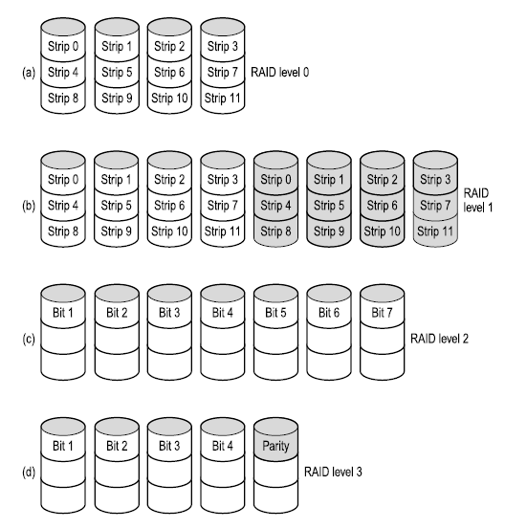
RAID (1)
Figure 5-20. RAID levels 0 through 3. Backup and parity drives are shown shaded.
Tanenbaum & Bo,Modern Operating Systems:4th ed., (c) 2013 Prentice-Hall, Inc. All rights reserved.

Slide 29
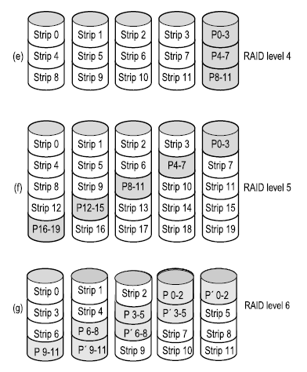
RAID (2)
Figure 5-20. RAID levels 4 through 6. Backup and parity drives are shown shaded.
Tanenbaum & Bo,Modern Operating Systems:4th ed., (c) 2013 Prentice-Hall, Inc. All rights reserved.

Slide 30

Disk Formatting (1)
Figure 5-21. A disk sector.
Tanenbaum & Bo,Modern Operating Systems:4th ed., (c) 2013 Prentice-Hall, Inc. All rights reserved.

Slide 31
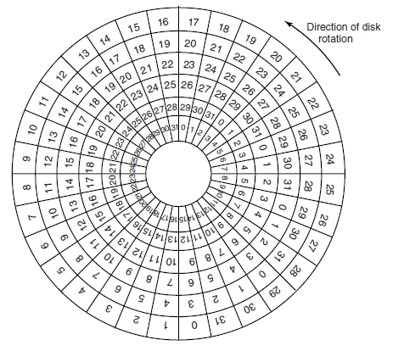
Disk Formatting (2)
Figure 5-22. An illustration of cylinder skew.
Tanenbaum & Bo,Modern Operating Systems:4th ed., (c) 2013 Prentice-Hall, Inc. All rights reserved.

Slide 32
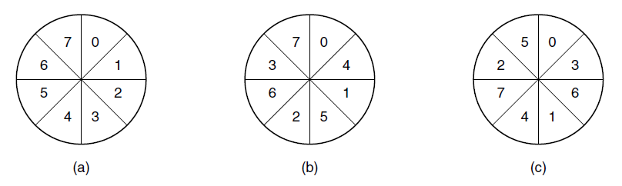
Disk Formatting (3)
Figure 5-23. (a) No interleaving. (b) Single interleaving.
(c) Double interleaving.
Tanenbaum & Bo,Modern Operating Systems:4th ed., (c) 2013 Prentice-Hall, Inc. All rights reserved.

Slide 33
Disk Arm Scheduling Algorithms (1)
Factors of a disk block read/write:
Seek time (the time to move the arm to the proper cylinder).
Rotational delay (how long for the proper sector to come under the head).
Actual data transfer time.
Tanenbaum & Bo,Modern Operating Systems:4th ed., (c) 2013 Prentice-Hall, Inc. All rights reserved.

Slide 34
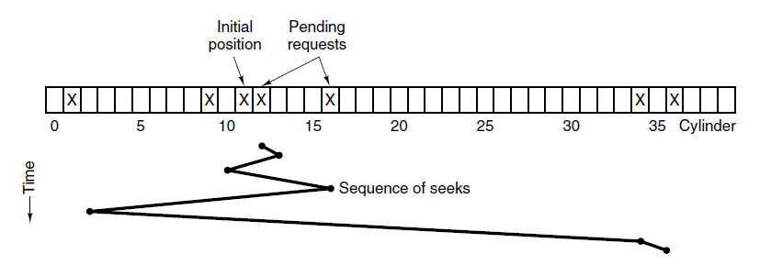
Disk Arm Scheduling Algorithms (2)
Figure 5-24. Shortest Seek First (SSF) disk scheduling algorithm.
Tanenbaum & Bo,Modern Operating Systems:4th ed., (c) 2013 Prentice-Hall, Inc. All rights reserved.

Slide 35
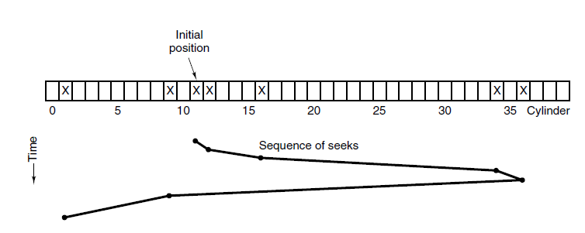
Disk Arm Scheduling Algorithms (3)
Figure 5-25. The elevator algorithm for scheduling disk requests.
Tanenbaum & Bo,Modern Operating Systems:4th ed., (c) 2013 Prentice-Hall, Inc. All rights reserved.

Slide 36
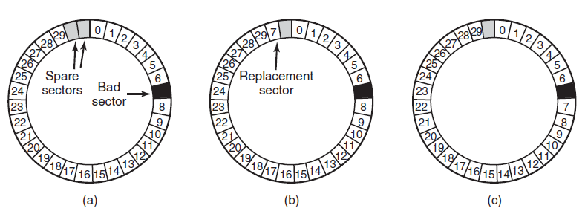
Error Handling
Figure 5-26. (a) A disk track with a bad sector. (b) Substituting a spare for the bad sector. (c) Shifting all the sectors to bypass the bad one.
Tanenbaum & Bo,Modern Operating Systems:4th ed., (c) 2013 Prentice-Hall, Inc. All rights reserved.

Slide 37
Stable Storage (1)
Uses pair of identical disks
Either can be read to get same results
Operations defined to accomplish this:
  Stable Writes
  Stable Reads
  Crash recovery
Tanenbaum & Bo,Modern Operating Systems:4th ed., (c) 2013 Prentice-Hall, Inc. All rights reserved.

Slide 38
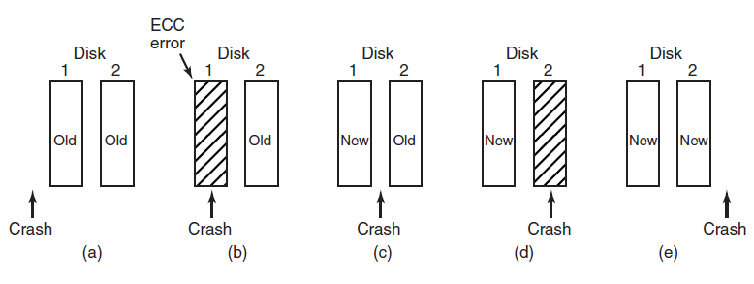
Stable Storage (2)
Figure 5-27. Analysis of the influence of crashes on stable writes.
Tanenbaum & Bo,Modern Operating Systems:4th ed., (c) 2013 Prentice-Hall, Inc. All rights reserved.

Slide 39
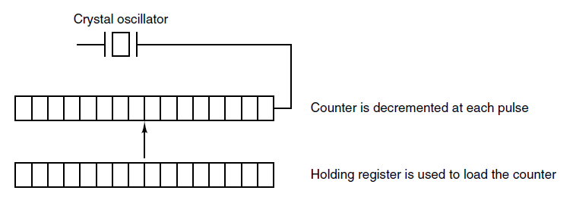
Clock Hardware
Figure 5-28. A programmable clock.
Tanenbaum & Bo,Modern Operating Systems:4th ed., (c) 2013 Prentice-Hall, Inc. All rights reserved.

Slide 40
Clock Software (1)
Typical duties of a clock driver:
Maintaining the time of day.
Preventing processes from running longer than allowed.
Accounting for CPU usage.
Handling alarm system call from user processes.
Providing watchdog timers for parts of system itself.
Profiling, monitoring, statistics gathering.
Tanenbaum & Bo,Modern Operating Systems:4th ed., (c) 2013 Prentice-Hall, Inc. All rights reserved.

Slide 41
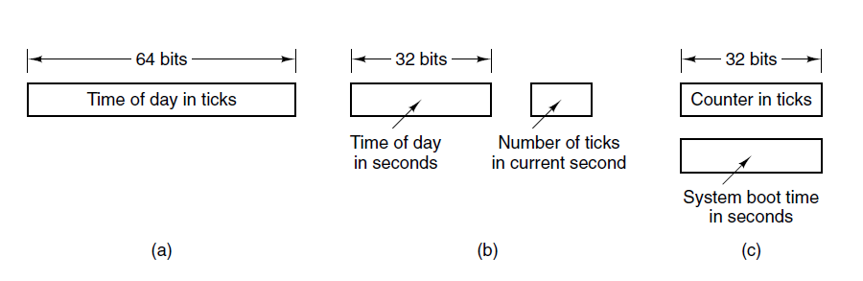
Clock Software (2)
Figure 5-29. Three ways to maintain the time of day.
Tanenbaum & Bo,Modern Operating Systems:4th ed., (c) 2013 Prentice-Hall, Inc. All rights reserved.

Slide 42
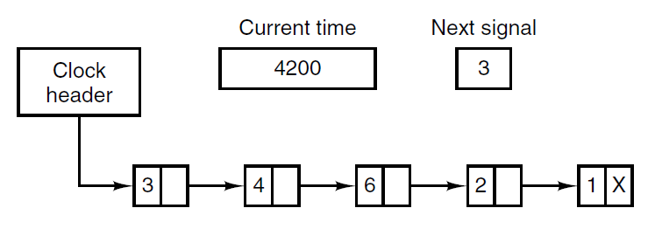
Clock Software (3)
Figure 5-30. Simulating multiple timers with a single clock.
Tanenbaum & Bo,Modern Operating Systems:4th ed., (c) 2013 Prentice-Hall, Inc. All rights reserved.

Slide 43
Soft Timers
Soft timers stand or fall with the rate at which kernel entries are made for other reasons. These reasons include:
      System calls.
      TLB misses.
      Page faults.
      I/O interrupts.
      The CPU going idle.
Tanenbaum & Bo,Modern Operating Systems:4th ed., (c) 2013 Prentice-Hall, Inc. All rights reserved.

Slide 44
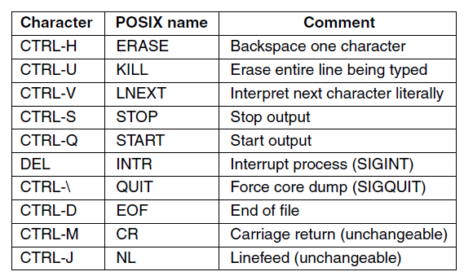
Keyboard Software
Figure 5-31. Characters that are handled
specially in canonical mode.
Tanenbaum & Bo,Modern Operating Systems:4th ed., (c) 2013 Prentice-Hall, Inc. All rights reserved.

Slide 45
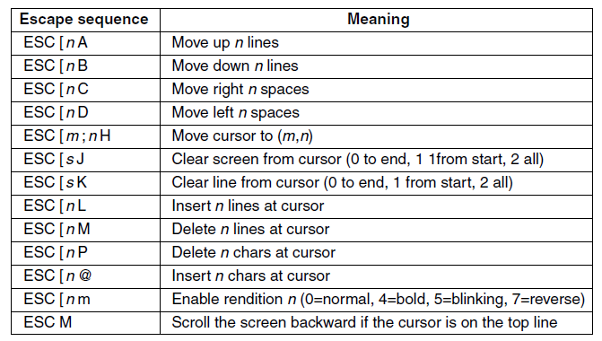
Output Software – Text Windows
Figure 5-32. The ANSI escape sequences accepted by the terminal driver on output. ESC denotes the ASCII escape character (0x1B), and n, m, and s are optional numeric parameters.
Tanenbaum & Bo,Modern Operating Systems:4th ed., (c) 2013 Prentice-Hall, Inc. All rights reserved.

Slide 46
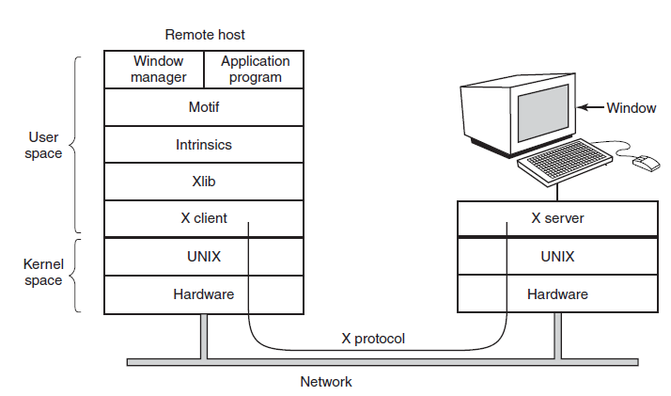
The X Window System (1)
Figure 5-33. Clients and servers in the M.I.T. X Window System.
Tanenbaum & Bo,Modern Operating Systems:4th ed., (c) 2013 Prentice-Hall, Inc. All rights reserved.

Slide 47
The X Window System (2)
Types of messages between client and server:
Drawing commands from program to workstation.
Replies by workstation to program queries.
Keyboard, mouse, and other event announcements.
Error messages.
Tanenbaum & Bo,Modern Operating Systems:4th ed., (c) 2013 Prentice-Hall, Inc. All rights reserved.

Slide 48
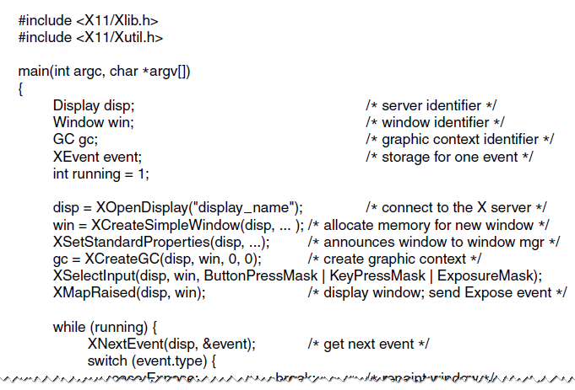
The X Window System (3)
Figure 5-34. A skeleton of an X Window application program.
Tanenbaum & Bo,Modern Operating Systems:4th ed., (c) 2013 Prentice-Hall, Inc. All rights reserved.

Slide 49
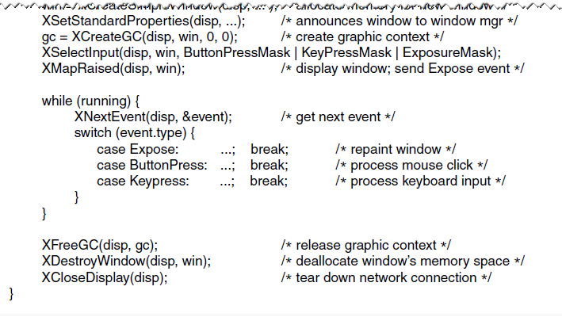
The X Window System (4)
Figure 5-34. A skeleton of an X Window application program.
Tanenbaum & Bo,Modern Operating Systems:4th ed., (c) 2013 Prentice-Hall, Inc. All rights reserved.

Slide 50
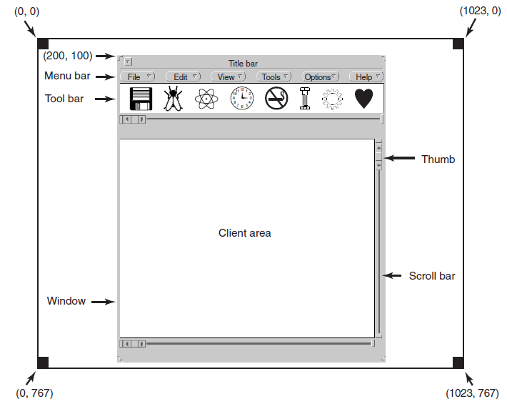
Graphical User Interfaces (1)
Figure 5-35. A sample window located at (200, 100)
on an XGA display.
Tanenbaum & Bo,Modern Operating Systems:4th ed., (c) 2013 Prentice-Hall, Inc. All rights reserved.

Slide 51
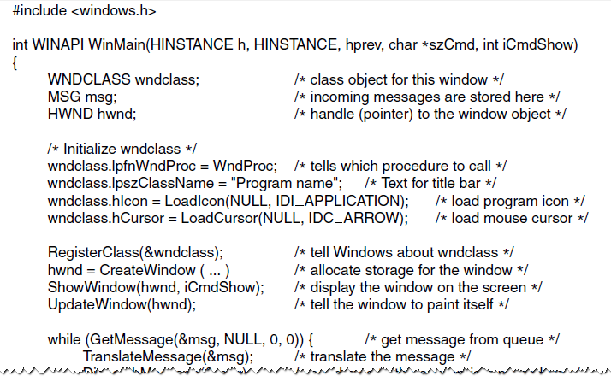
Graphical User Interfaces (2)
Figure 5-36. A skeleton of a Windows main program.
Tanenbaum & Bo,Modern Operating Systems:4th ed., (c) 2013 Prentice-Hall, Inc. All rights reserved.

Slide 52
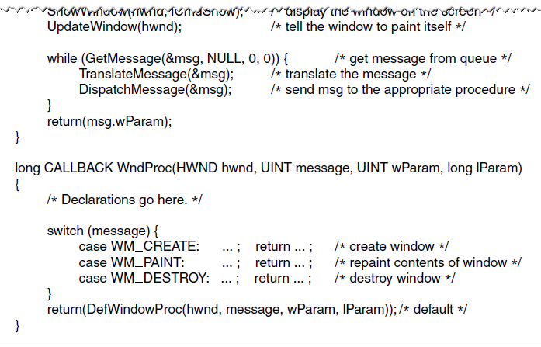
Graphical User Interfaces (3)
Figure 5-36. A skeleton of a Windows main program.
Tanenbaum & Bo,Modern Operating Systems:4th ed., (c) 2013 Prentice-Hall, Inc. All rights reserved.

Slide 53
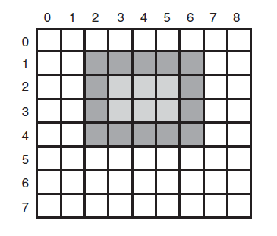
Graphical User Interfaces (4)
Figure 5-37. An example rectangle drawn using Rectangle. Each box represents one pixel.
Tanenbaum & Bo,Modern Operating Systems:4th ed., (c) 2013 Prentice-Hall, Inc. All rights reserved.

Slide 54
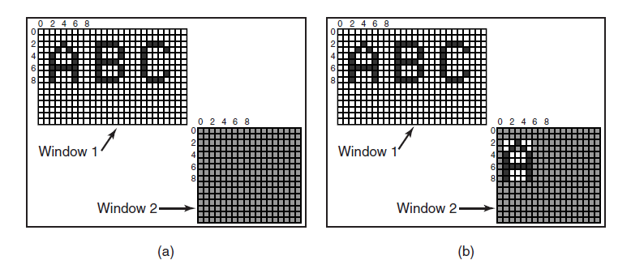
Bitmaps
Figure 5-38. Copying bitmaps using BitBlt.
(a) Before. (b) After.
Tanenbaum & Bo,Modern Operating Systems:4th ed., (c) 2013 Prentice-Hall, Inc. All rights reserved.

Slide 55
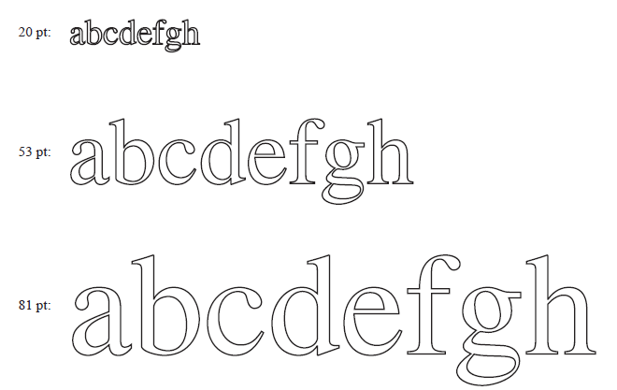
Fonts
Figure 5-39. Some examples of character outlines
at different point sizes.
Tanenbaum & Bo,Modern Operating Systems:4th ed., (c) 2013 Prentice-Hall, Inc. All rights reserved.

Slide 56
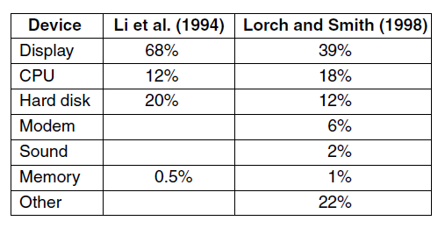
Hardware Issues
Figure 5-40. Power consumption of various
parts of a notebook computer.
Tanenbaum & Bo,Modern Operating Systems:4th ed., (c) 2013 Prentice-Hall, Inc. All rights reserved.

Slide 57
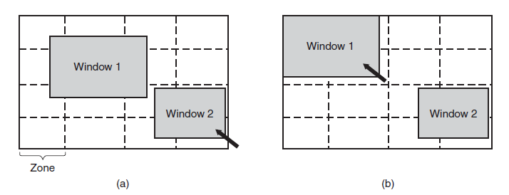
Operating System Issues
The Display
Figure 5-41. The use of zones for backlighting the display.
(a) When window 2 is selected it is not moved.
(b) When window 1 is selected, it moves to reduce the number of zones illuminated.
Tanenbaum & Bo,Modern Operating Systems:4th ed., (c) 2013 Prentice-Hall, Inc. All rights reserved.

Slide 58
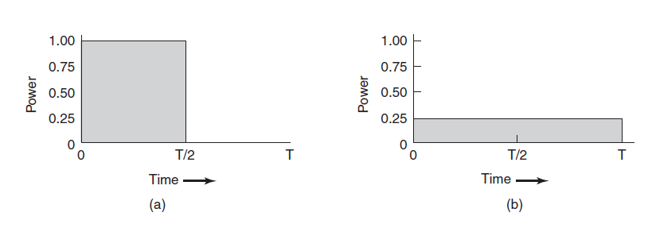
Operating System Issues
The CPU
Figure 5-42. (a) Running at full clock speed. (b) Cutting voltage by two cuts clock speed by two and power consumption by four
Tanenbaum & Bo,Modern Operating Systems:4th ed., (c) 2013 Prentice-Hall, Inc. All rights reserved.

Slide 59
End
Chapter 5
Tanenbaum & Bo,Modern Operating Systems:4th ed., (c) 2013 Prentice-Hall, Inc. All rights reserved.

